Slide 1
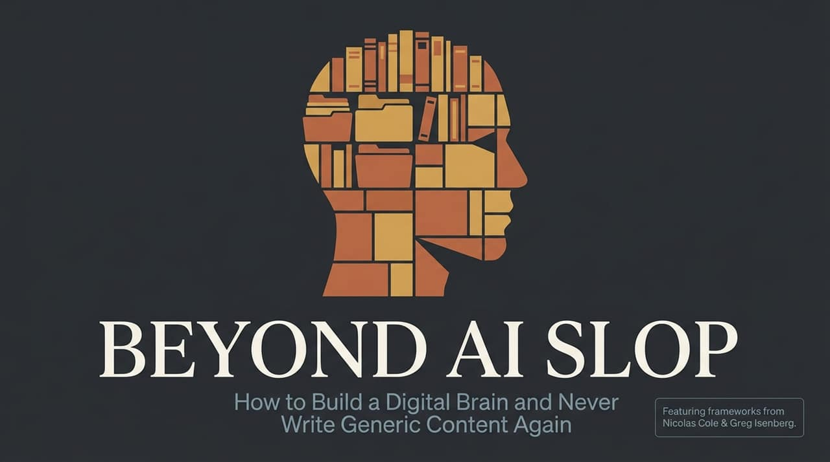
Notes:
Opening / Hook:
Good morning/afternoon, everyone. Look around social media, blogs, or company newsletters today, and you’ll notice a massive trend: an ocean of repetitive, generic content. We call this AI Slop.
The Core Problem:
In the age of Large Language Models, anyone can prompt an AI to generate endless blog posts or social media captions in seconds. But because everyone is drawing from the same base public data, almost all of it sounds like an automated encyclopedia entry—bland, forgettable, and totally unattached to human identity.
Session Objective: Today, we are going to walk through a framework developed by Nicolas Cole and Greg Isenberg. By the end of this presentation, you will understand how to build a Digital Brain—or a Personal Language Model (PLM)—that allows you to leverage AI for leverage and scale without ever publishing low-value, generic 'slop' again.
$30M Writer: Never write AI slop again
https://www.youtube.com/watch?v=YuOSyRj3sXg

Slide 2
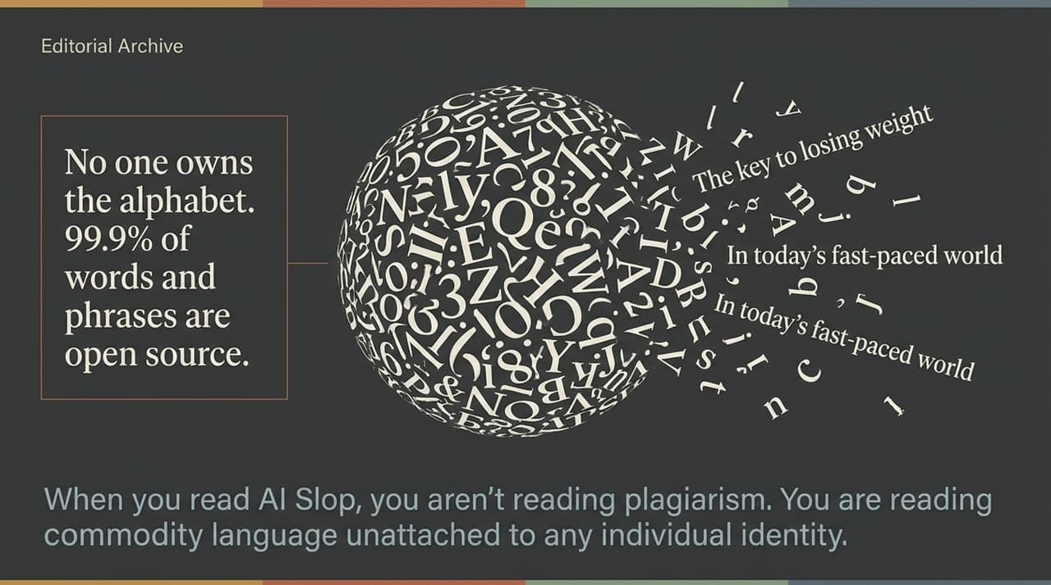
Notes:
Deconstructing Language:
To understand why AI output feels so robotic, we have to examine what language actually is. The English language is essentially open source. No single individual owns the letter 'A', the word 'catastrophe', or common phrases like 'In today’s fast-paced world'.
Why AI Slop Isn't Plagiarism: When people criticize AI-generated text, they often mistake it for plagiarism. But it’s not plagiarism—it’s Commodity Language. If someone says 'The key to losing weight is eating healthy,' thousands of people have said those exact words. Nobody owns that phrase.
The Identity Gap:
AI Slop feels empty because it consists of open-source language unattached to a specific human point of view or experience. When you publish open-source phrases without personal grounding, you are sharing content that could have been written by literally anyone—or anything.

Slide 3
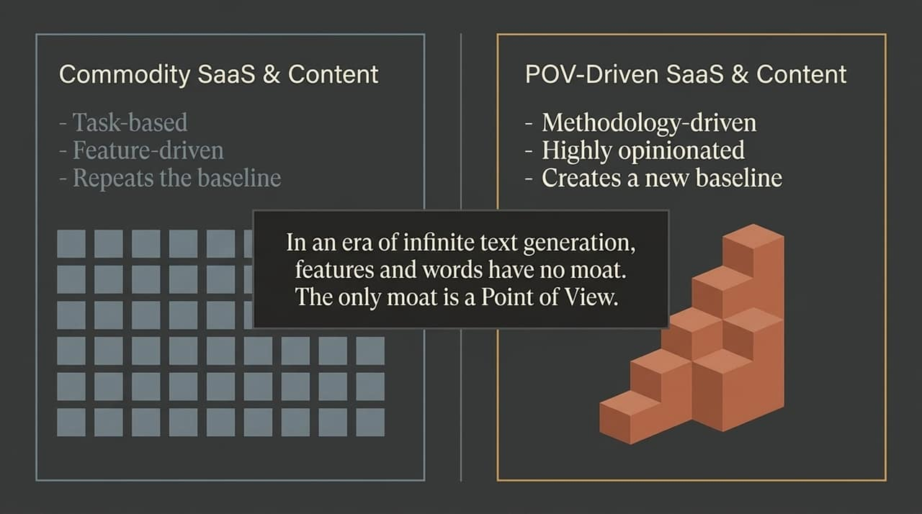
Notes:
The Death of Feature/Word Moats:
Many founders and creators claim that in the AI era, SaaS and content no longer have moats because code and copy can be generated instantly. That is only true if you are building or writing commodity assets.
Commodity vs. POV-Driven: Commodity SaaS is task-based and feature-driven—like a standard scheduling or notes app. Anyone can copy those features overnight using AI. Commodity content does the same thing: it repeats baseline industry facts.
Creating a True Moat:
A real moat comes from a strong, methodology-driven Point of View (POV). When your product or content is built around a distinct methodology (e.g., Typeshare’s framework for personal language models), competitors can't simply copy a feature. To replicate you, they constantly have to look back at your thinking to figure out what to do next. You stay steps ahead because you own the methodology.

Slide 4
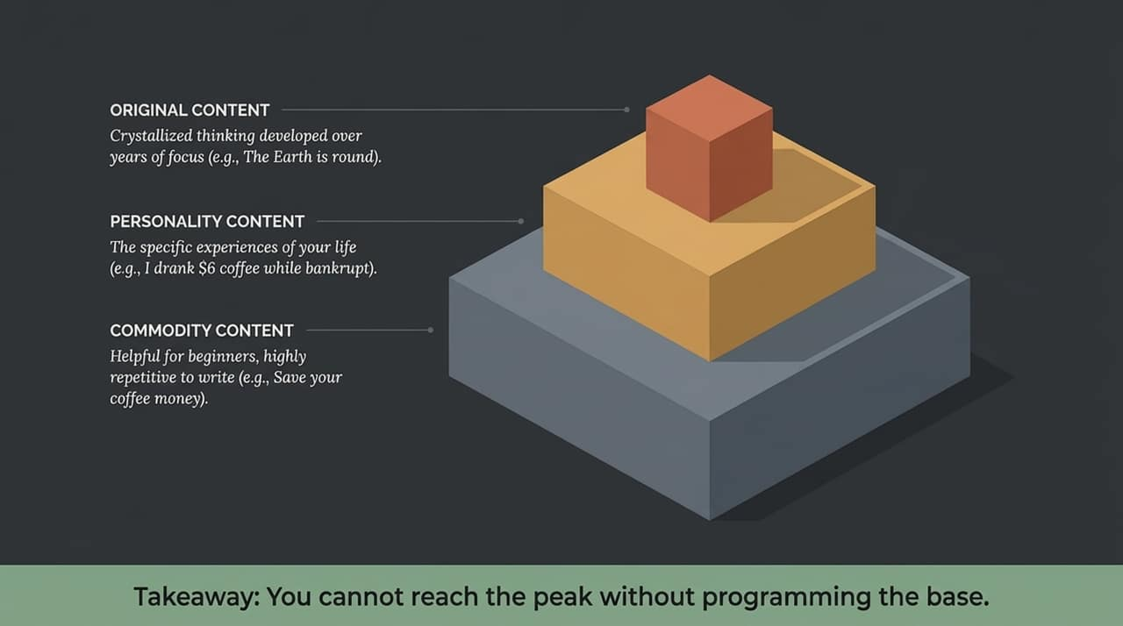
Notes:
The Three Tiers of Content:
Commodity Content: General advice ('You should buy the S&P 500'). Helpful for beginners, but easy for AI to replicate endlessly.
Personality Content: Specific personal experiences ('When I was 17, I was a top-ranked World of Warcraft player'). Impossible for AI to fake cleanly because it relies on your proprietary history.
Original Content: Crystallized, novel breakthroughs built over years of focus ('The Earth is round').
The You Should vs. I Did Trap:
When you write from a 'You should...' perspective, your content naturally drifts toward commodity advice. But when you write from an 'I think / I did...' framing, you automatically pivot into Personality Content.
Key Takeaway: You cannot reach original, game-changing ideas without first programming the base layer of your personal stories and observations.

Slide 5
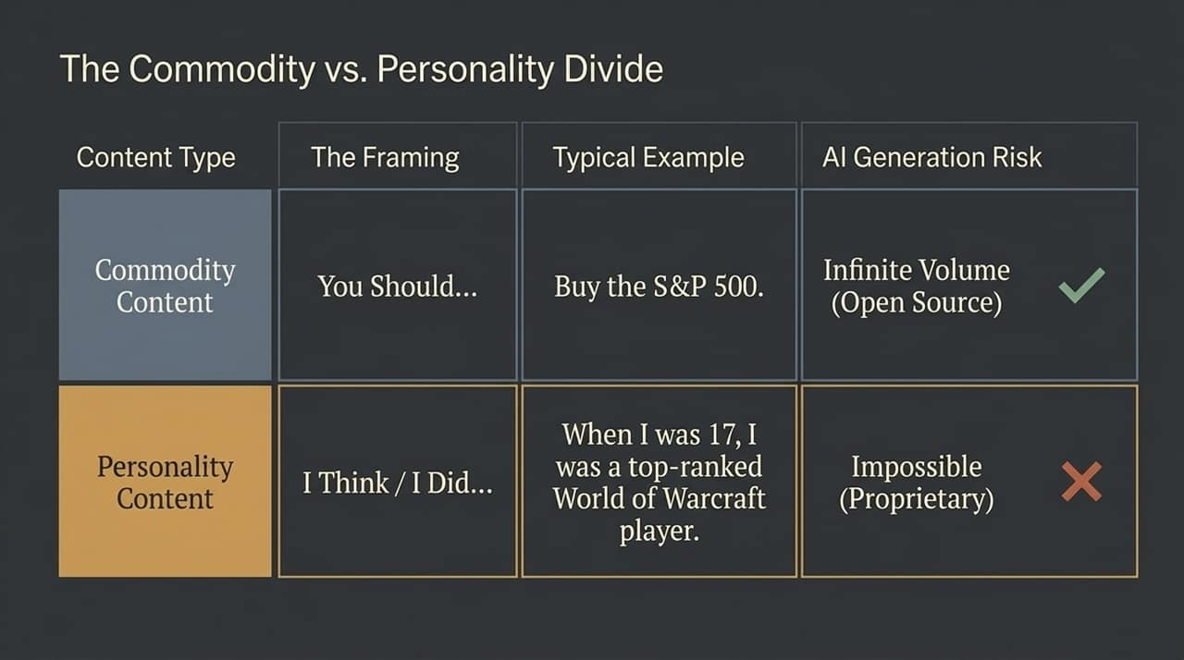
Notes:
Public vs. Proprietary Data:
AI models like ChatGPT and Claude are trained on public data. That’s why their default answers sound identical. Your life history—your childhood, the mistakes you made, moving across the country, your obscure hobbies—is what we call The Unmade Data Set.
Mundane Stories as High-Value Assets:
We often assume our personal experiences are too boring to write about. But sharing specific, mundane experiences—like moving coast-to-coast or blowing your savings on a failed project—is what creates immediate human connection.
Fishing with Dynamite: When you inject details from your unmade data set into common industry topics, you are 'fishing with dynamite in a sea of generic language'. It immediately cuts through the noise because AI cannot hallucinate your exact lived context without you feeding it.

Slide 6
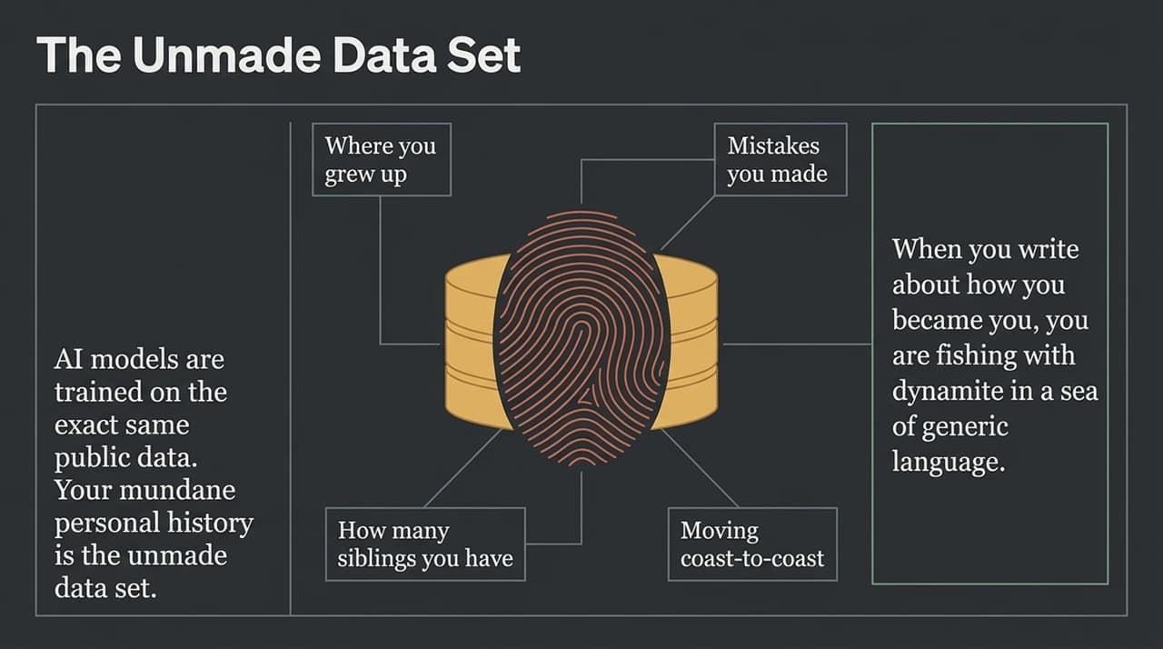
Notes:
Building a Personal Language Model:
Instead of letting AI generate ideas for you, you build a structured library of your ideas, stories, and preferred phrasing. This is your Personal Language Model (PLM).
The 4 Essential Folders:
Commodity Ideas I Agree With: Industry standards you endorse (e.g., 'Dollar-cost averaging into index funds').
Commodity Ideas I Disagree With: Common stances you oppose (e.g., 'Skipping $3 coffee makes you rich').
My Formative Stories: Your unmade data set—case studies, failures, background facts.
My Approved Vocabulary: Specific phrases, terminology, and syntax you prefer.
Why This Prevents Slop:
AI produces slop when it doesn't know which side of a debate you stand on. Once your PLM explicitly stores your positions and stories, the AI knows exactly how to represent you.

Slide 7
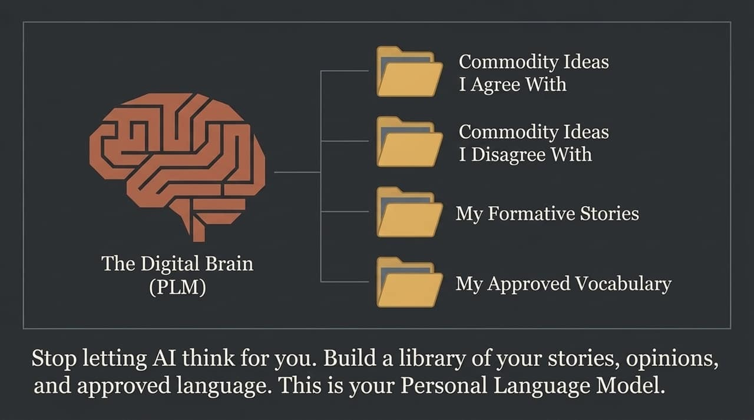
Notes:
The Division of Labor:
The fundamental mistake people make with AI is asking the robot to do the primary thinking. That reverses the proper workflow.
The 3-Step Workflow:
Step 1 (Human Input): The human writes to discover a point of view, capture personal anecdotes, and refine ideas.
Step 2 (The Archive/Storage): These ideas and phrases are categorized inside your Digital Brain/PLM.
Step 3 (Robot Output): The AI takes your approved language and remixes, formats, and distributes it across multiple formats and platforms.
The Golden Rule:
Humans do the thinking; robots do the repeating. Use AI to scale up your existing thoughts into 10 new variations rather than asking it to generate an essay from scratch.

Slide 8
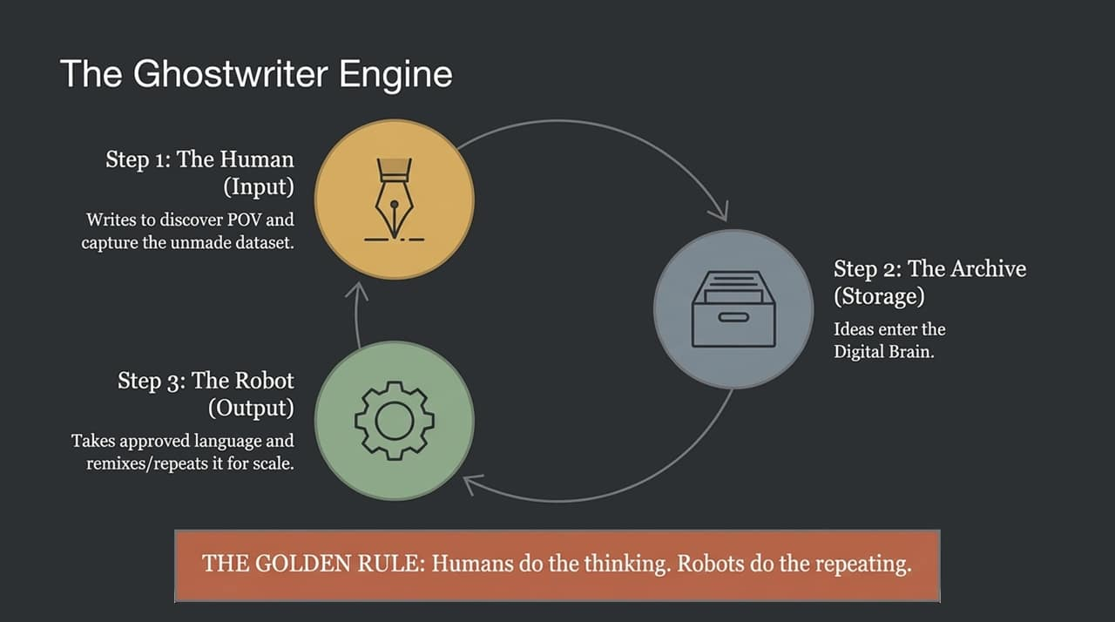
Notes:
Voice Is Programmable Data:
People treat 'voice' as an unexplainable, magical quality. In reality, voice is just a bundle of specific, programmable choices.
The Voice Parameters:
Sentence Length & Syntax: Short and punchy vs. long and academic.
Vocabulary Selection: Using 'Exquisite' vs. 'Dope' radically changes the persona.
Evidence Type: Do you prove your points with personal anecdotes or by citing academic research?
Fixing AI Outputs:
When an AI output feels 'wrong,' don't throw it out. Usually, it just misfired on one parameter—like using corporate jargon instead of punchy sentences. Explicitly prompt or configure your model with these parameters to maintain consistent tone.

Slide 9
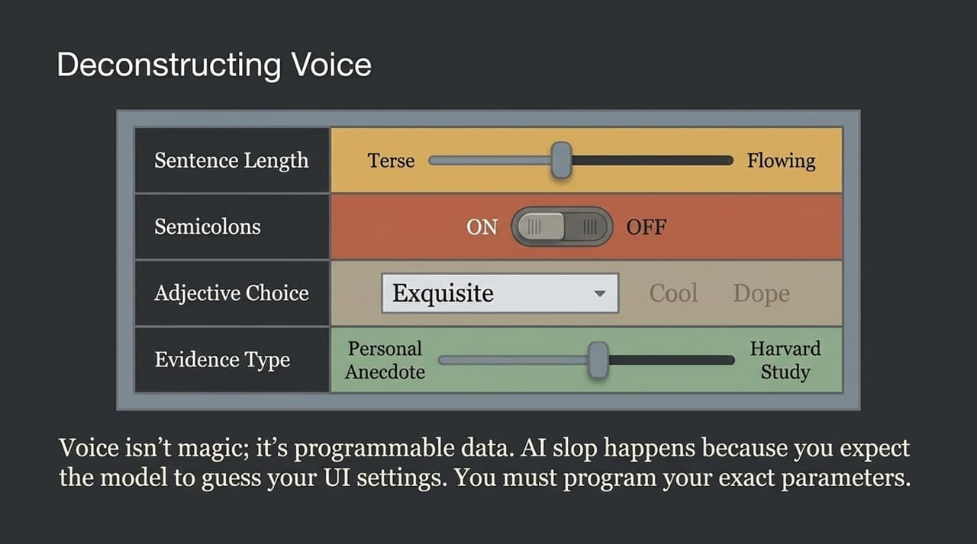
Notes:
Understanding Content Leverage:
Before you spend time creating any piece of content, ask yourself: What is its value horizon?
Timely Content:
Memes, news jackings, or trending reactions (e.g., commenting on an Apple announcement). They yield a quick spike in engagement over 24 hours, but their value drops to zero immediately after.
Timeless Content:
Deep-dive essays, frameworks, and core methodology pieces. They may get modest initial traction, but they compound exponentially over 5 to 10 years.
Strategic Balance:
Timely content gives short-term visibility, but timeless content permanently strengthens your Digital Brain. Strive to spend the majority of your deep thinking time on timeless assets.

Slide 10
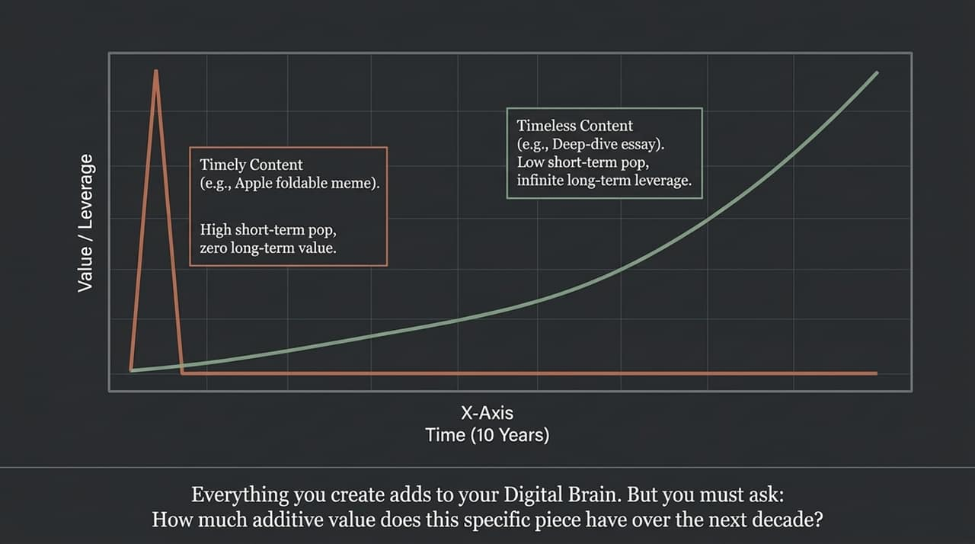
Notes:
The Failure of Corporate Megaphones:
For decades, corporate marketing acted like a megaphone: broadcasting product features and announcements. Today, audiences tune out faceless corporate announcements.
Human-Centric Content:
Instead of announcing 'We made a new burrito,' share a story about Tiffany, an employee in Tulsa whose parents met at Taco Bell. That shifts corporate messaging into Personality Content.
The Dual-Leverage Model for Brands:
Branded channels scale by repeating core commodity ideas. But they win trust and differentiation by highlighting real human personalities—whether executives, employees, or customers.

Slide 11
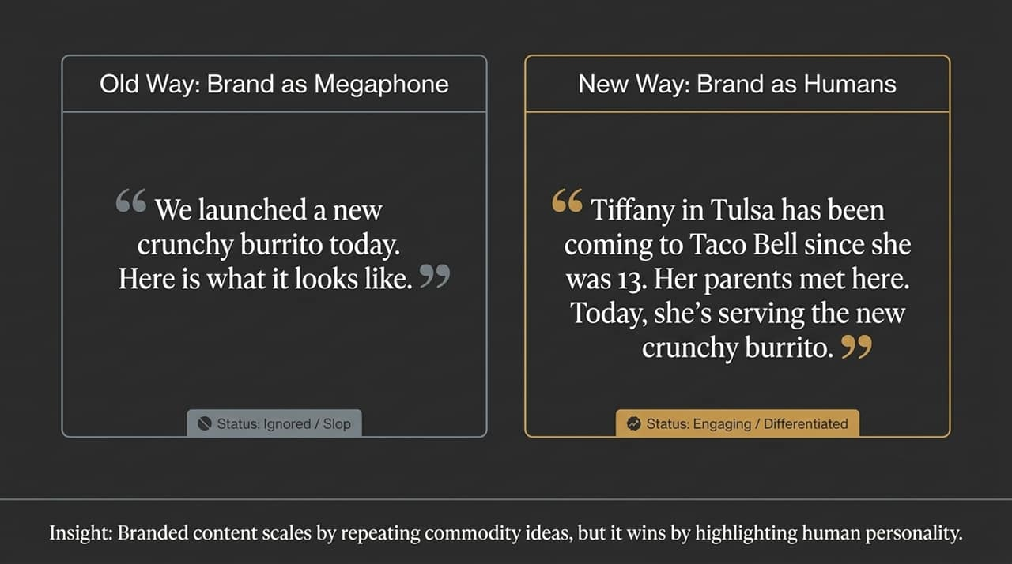
Notes:
Redefining Content Ownership:
Since language is open source, 'owning' an idea online simply means Association. You 'own' a topic when the audience automatically connects that perspective with your name.
Achieving Association Through Volume:
The most direct way to establish association is through consistency and scale. In today’s fast-moving algorithmic feeds, publishing once a week is insufficient to build strong mental associations.
The Role of Systems:
Publishing 5 times a day sounds overwhelming if you do it manually. But once you have a Digital Brain filled with approved language, AI tools can help re-format, slice, and schedule your core ideas across multiple platforms effortlessly.

Slide 12
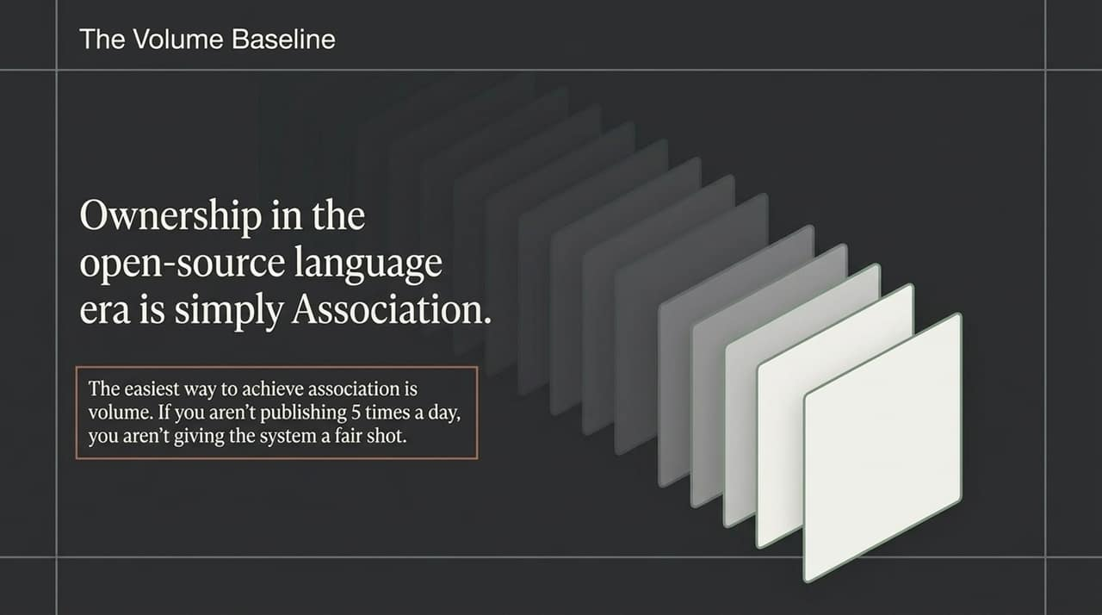
Notes:
Proprietary Content Datasets:
Major corporations are spending hundreds of millions of dollars licensing structured content datasets to train AI models. But internal institutional knowledge is often completely uncaptured.
The Corporate Brain as a Moat:
Hiring a deep thinker or senior journalist whose sole job is to interview internal experts and build a structured library of original thought is one of the highest-ROI marketing investments a Fortune 500 company can make.
Operationalizing Thought Leadership:
Once a company captures its unique methodologies in a 'Company Brain', automated pipelines can generate social posts, sales scripts, and training materials grounded in company IP.

Slide 13
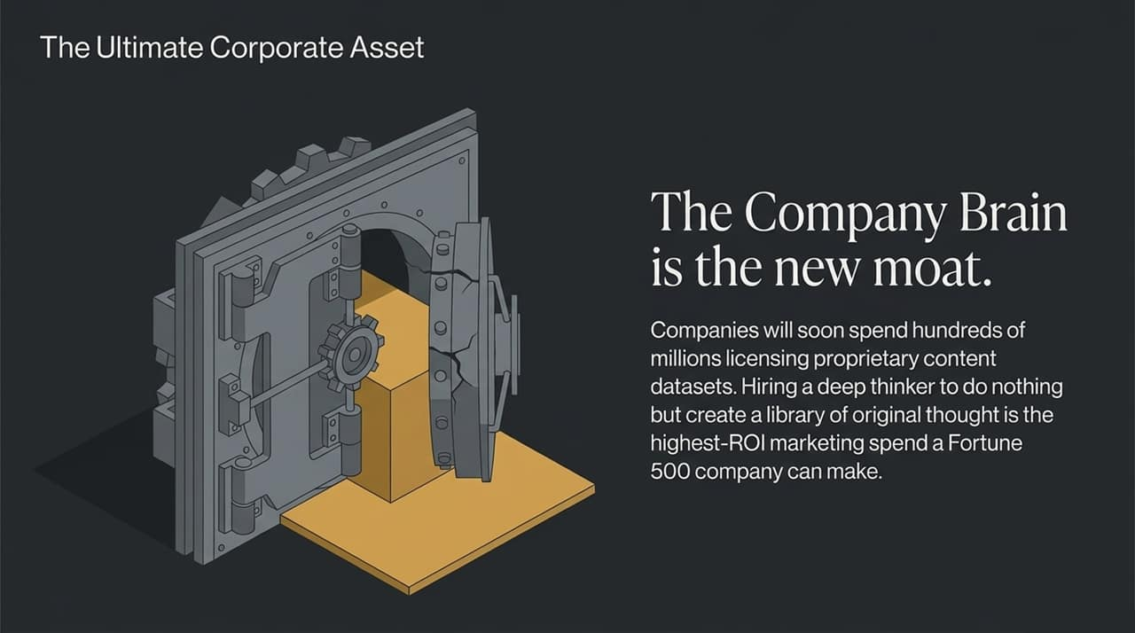
Notes:
Recapping the core principles:
Own your Point of View: Differentiate through unique methodology, not generic features or open-source statements.
Mine your Unmade Data Set: Consistently document the mundane, formative, and personal details of your real life.
Program your Voice parameters: Define exact syntax, word choices, and structural preferences so AI can match your style.
Assign the Labor correctly: Let humans do the original thinking, and let AI do the formatting and repetition.

Slide 14
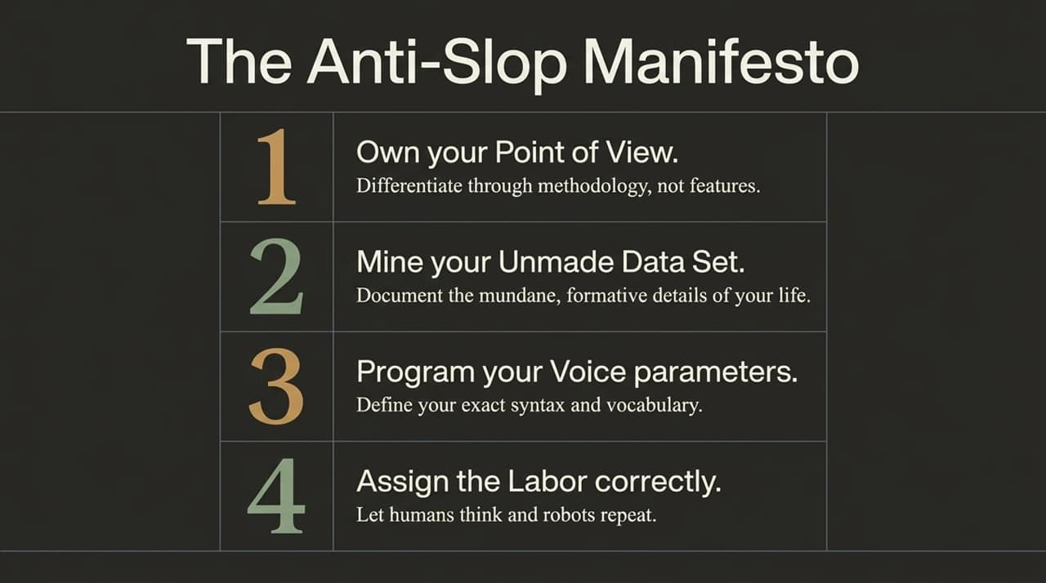
Notes:
Call to Action: Before you draft your next article, post, or campaign, ask yourself: Am I contributing new thinking to my Digital Brain, or am I just echoing public AI slop?
Next Steps: Start small: set up a repository (in Obsidian, Notion, or Typeshare). Record 5 stories from your past, list 5 industry norms you disagree with, and list 5 core principles you live by. That is seed data for your Personal Language Model.

Slide 15
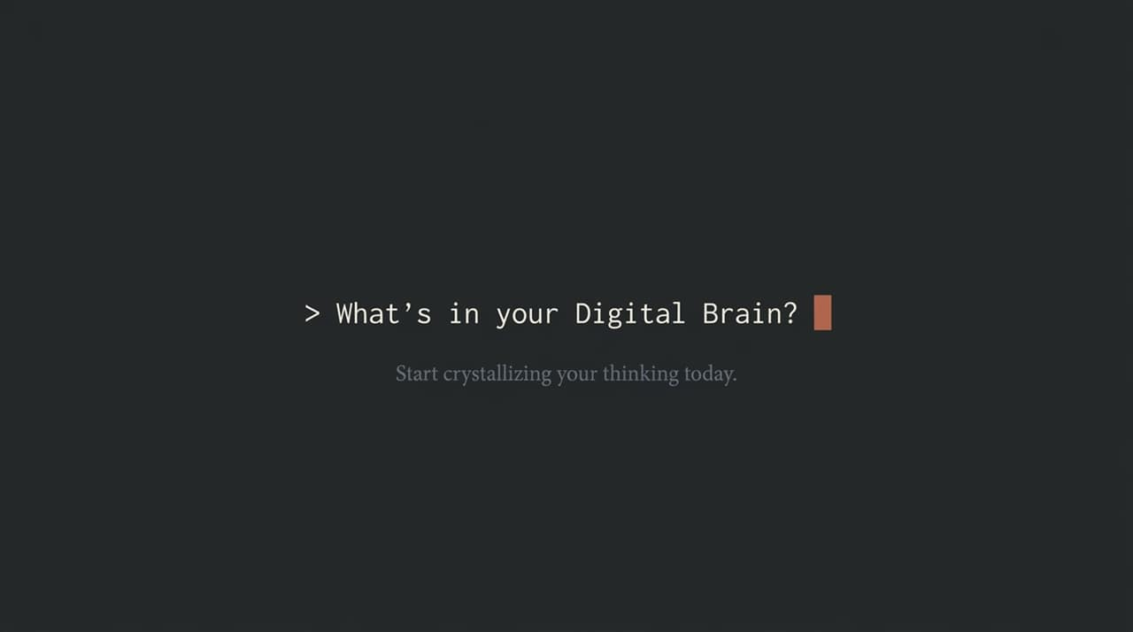
Notes:
Reviewing the Spectrum:
Commodity Content: Drawn from open-source language/facts. Low leverage because AI can easily replicate it.
Personality Content: Drawn from unique life experiences. High leverage because AI needs you to feed it your lived experience.
Original Content: Developed through years of deep thinking. Highest leverage because it creates a lasting, defensible moat.
Execution Strategy:
Aim for an 80/20 balance: use AI to remix approved commodity ideas (80%) while focusing your personal time on capturing subjective personality stories and original ideas (20%).

Slide 16
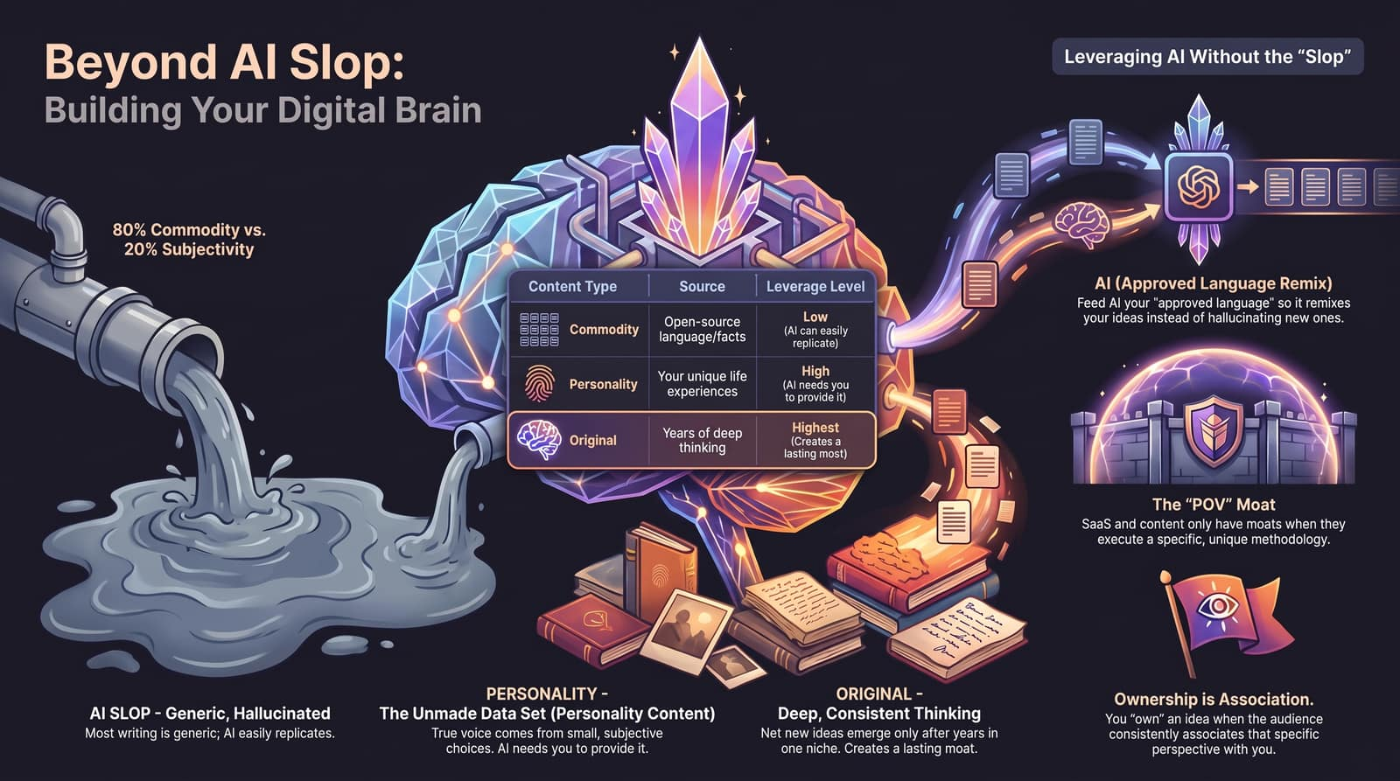
Notes:
Final Synthesis:
To bring everything together:
AI Slop happens when you rely on unguided AI outputs.
Personality Content forms your Unmade Data Set.
Original Content builds long-term authority and brand equity.
Ownership is Association: publishing high volumes of approved language establishes your brand as the definitive authority on your topic.
Closing Statement: Stop letting AI think for you. Start using AI to amplify, remix, and scale your personal voice and point of view. Thank you!
$30M Writer: Never write AI slop again
https://www.youtube.com/watch?v=YuOSyRj3sXg

